Slide 1
CSE 11
Accelerated Intro to Programming Discussion Section 8
Sachin Deshpande
Summer 1 2021
This discussion is being recorded

Slide 2
Logistics
PA8 released
Exam Friday

Slide 3
Generic Methods
Enable us to run the same code for multiple data types
we use <> to specify parameter types in generic method and class creation
The type parameter's name is our choice, such as T, U

Slide 4










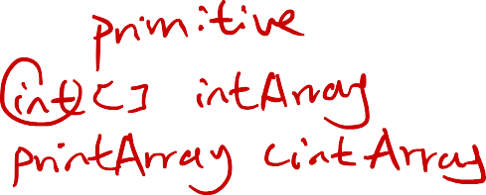






Example : generic method to print elements in array
public class GenericMethodTest {
public static < E > void printArray( E[] inputArray ) { for(E element : inputArray) { System.out.println(element);
}
}
public static void main(String args[]) {
// Create arrays of Integer, Double and Character Integer[] intArray = { 1, 2, 3, 4, 5 };
Double[] doubleArray = { 1.1, 2.2, 3.3, 4.4 }; Character[] charArray = { 'H', 'E', 'L', 'L', 'O' };
printArray(intArray); // pass an Integer array printArray(doubleArray); // pass a Double array printArray(charArray); // pass a Character array
}
}
Boxed Primitives!

Slide 5


Generic Interfaces and Classes
write it in front of the name of the interface or class instead
interface Checker<T> {
boolean check(T t); // We can use T here.
}
notable difference between generic methods and classes is that when using generic classes/interfaces, Java won't figure out the actual types for us, and we need to provide them manually
class LongTweet implements Checker<TextTweet> { // We need to provide the TextTweet type here ... public boolean check(TextTweet t) {
return t.content.length() > 20;
}
}

Slide 6










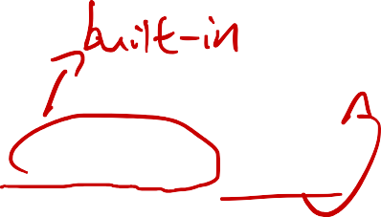











Lists and ArrayLists
ArrayList is an implementation of List interface provided by Java
we used regular arrays to store lists of data, read them, and modify them. ArrayLists are a generic type in Java that allows us to do all the same things, with slightly different syntax:
int[] numArray = {1, 2, 3}; | List<Integer> numList = Arrays.asList(1, 2, 3);
int one = numArray[0]; | int anotherOne = numList.get(0);
numArray[1] = one * 2; | numList.add(1, anotherOne * 2);
for (int num: numArray) { /* ... */} | for (Integer num: numList) { /* ... */}

Slide 7



Lists and ArrayLists
The key distinction between arrays and ArrayLists is that ArrayLists are resizable, so we can add and remove values from them
List<String> messages = Arrays.asList("Hello", "CSE11");
// Appends "on your assignments!" to the end of messages messages.add("on your assignments!");
// Inserts "Good luck" at index 2, shifting "on your assignments!" to the right. messages.add(2, "Good luck");
// Removes "Hello" from the list, and returns it. String hello = messages.remove(0);

Slide 8













Overloading
providing multiple implementations of the same method, differentiated by the
parameters they accept
int add(int a, int b) { /* ... */}
double add(double a, double b) { /* ... */}
only works if the different method have a different number of parameters, or parameters of different types , but not if they only have different return types
A common use for overloading methods is to provide default parameters. For instance, the following method is overloaded to use a default length of 5
/*
This method returns a new ArrayList containing the Strings in `strs` that are longer than `length`.
*/
static ArrayList<String> longStrings(ArrayList<String> strs, int length) {
...
}
static ArrayList<String> longStrings(ArrayList<String> strs) { return longStrings(strs, 5);
}

Slide 9























Exceptions
Java's way of handling errors that can happen when we run our programs
run into exceptions as a result of incorrect/buggy code as well. Some of these exceptions include:
ArrayOutOfBoundsException: Happens when we try to get the element at an index of an array that doesn't exist
NullPointerException: Happens when we try to read a field of, or call a method on a null value.
ArithmeticException: Happens when we try to run an invalid arithmetic operation (e.g. divide by zero)
we can provide a custom, more descriptive, error message while throwing exceptions
static Integer max(ArrayList<Integer> elements) { if (elements.size() == 0) {
throw new IllegalArgumentException("max got an empty list");
}
/* ... */
}

Slide 10
PA8
Start early!

Slide 11
Thanks!

